Slide 1
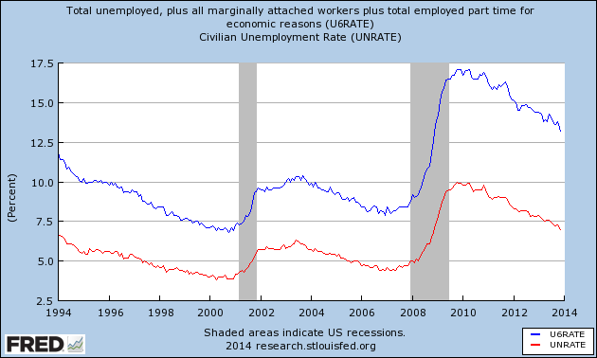
Unemployment Rate and the U-6 Rate

Slide 2
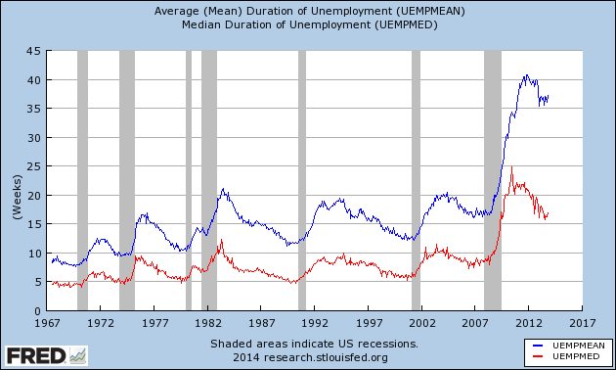
Duration of Unemployment

Slide 3
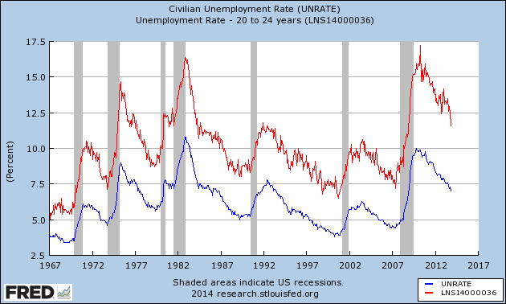
Unemployment Rate, Younger Workers

Slide 4
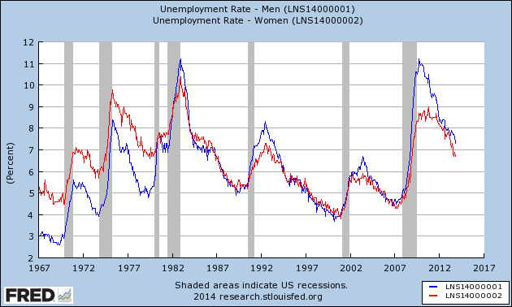
Unemployment Rate by Gender

